Slide 1






NEUROVOICE
CAPSTONE

Slide 2
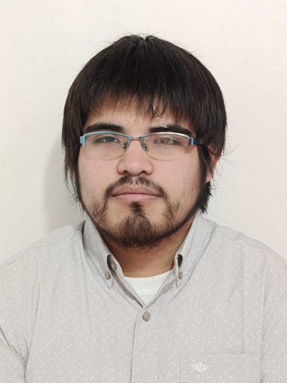

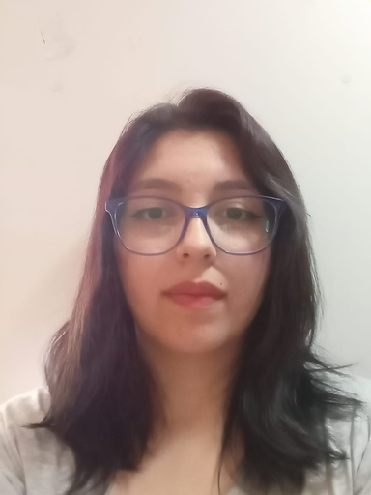
NeuroVoice
TEAM MEMBERS
ESTEBAN FIERRO
Position: Leader / Developer
Responsibilities:
Coordinate the project
Prioritize tasks and objectives
Maintain basic technical documentation
FRANCISCA HERRERA
Position: Coordinator / Developer
Responsibilities:
Facilitate team collaboration
Manage obstacles
Support the team
Develop functionalities

Slide 3
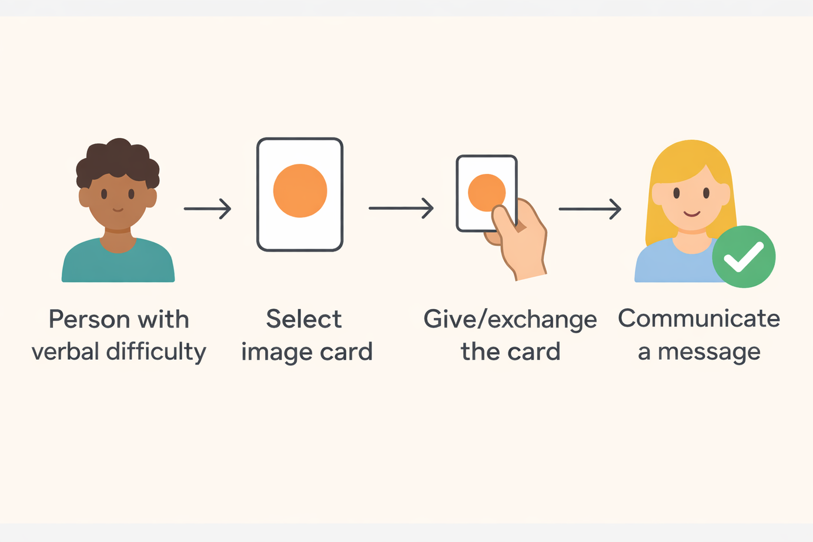
CONTEXT
Communication cards are visual representations used to support individuals who have difficulties expressing themselves verbally. They allow messages to be conveyed through images that represent objects, activities, or ideas, facilitating interaction and daily communication.
NeuroVoice

Slide 4





PROBLEM
Physical non-verbal communication cards are not very portable, difficult to customize, and not very engaging for neurodivergent children, which hinders communication and can lead to frustration.
SOLUTION
NeuroVoice digitizes these cards into a mobile app with images, categories, and audio, providing an inclusive, practical tool adapted to modern times to improve daily communication.
NeuroVoice

Slide 5



NeuroVoice
TARGET AUDIENCE
Primary
Kindergarten and first-grade children who are still developing the ability to identify and regulate their emotions.
This aims to support early emotional recognition and management, especially considering potential needs related to neurodivergence.
Secondary
Neurodivergent individuals who require support to communicate emotions.
Educators, psychology professionals, and classroom assistants who support socio-emotional development processes.

Slide 6

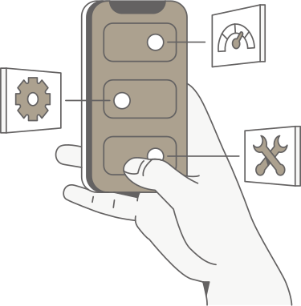




GENERAL OBJECTIVE
Develop a mobile application that facilitates communication for neurodivergent individuals through the use of accessible digital cards.
SPECIFIC OBJECTIVES
Design an accessible and user-friendly interface.
Implement digital cards with categories, images, and audio.
Allow visual customization according to user needs.
Integrate text-to-speech (TTS) audio to enhance communication.
Conduct testing on mobile devices.
NeuroVoice

Slide 7
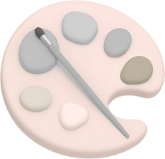








SCOPE
Customization of the app’s overall color theme.
Audio playback through TTS.
System with a login service.
Backend implemented with Flask and an SQLite database.
Creation of a REST API within the system.
Ability to create and delete collections.
Allows adding and removing cards within collections.
Implementation of a search feature with filters for cards.
LIMITATIONS
The application works only with internet access.
Development time is limited to 3 months.
There is no interaction between users within the system.
There is no data synchronization with external servers.
NeuroVoice

Slide 8




NeuroVoice
AGILE METHODOLOGY
Roles:
Product Owner
Scrum Master
Scrum Team
Epics focus on:
Accessible interface
Digital cards
Assisted communication
Personalization
Each epic is broken down into clear and measurable user stories.
Work is carried out in short sprints, integrating features such as new cards, UI improvements, audio, and personalization. Continuous integration and testing on real devices are applied, with flexibility to adjust based on specialist recommendations. Incremental deliveries allow accessibility and usability to be validated from an early stage.

Slide 9
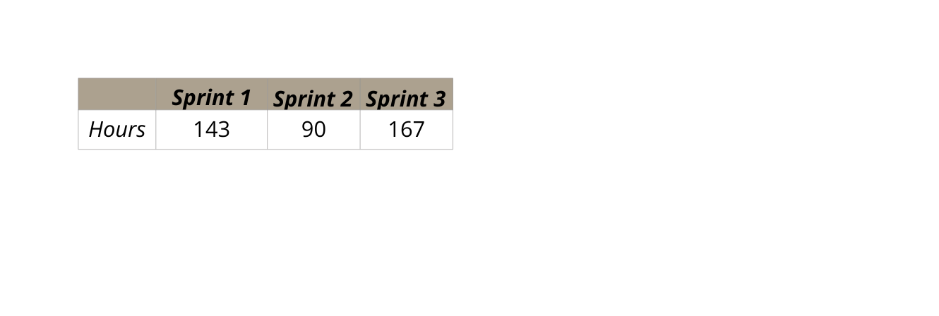

PROJECT SCHEDULE
Phase1 : Defining the main idea
Role assignment.
Methodology selection.
Phase3: Final meeting with clients
Final adjustments and improvements.
Final documentation delivery.
Phase2 : Base documentation
Project programming and construction
NeuroVoice

Slide 10
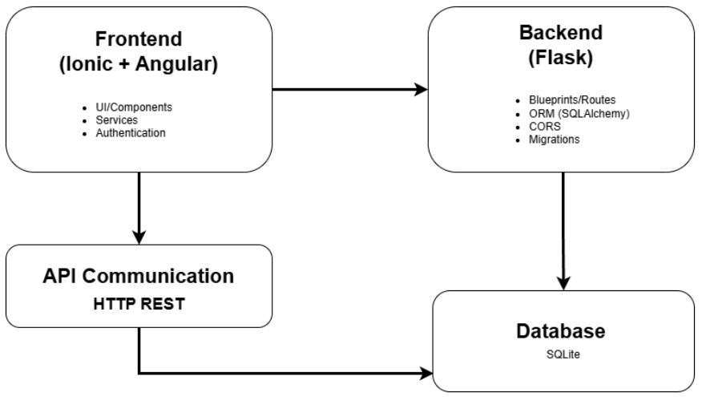



ARCHITECTURE
The architecture is based on two separate repositories.
Both communicate through an API, which is responsible for sending and receiving data between the application and the database, which is managed by the backend.
NeuroVoice

Slide 11

BACKEND
FRONTEND
Framework: Flask
Lenguaje: Python
Database: SQLite
Framework: Ionic
Lenguaje: TypeScript
Local Database: IndexedDB
TOOLS
Graphic Resources: Free-to-use icons and images
Target Devices: Android / iOS
TECHNOLOGIES USED
NeuroVoice

Slide 12
APPLICATION DEMONSTRATION

Slide 13
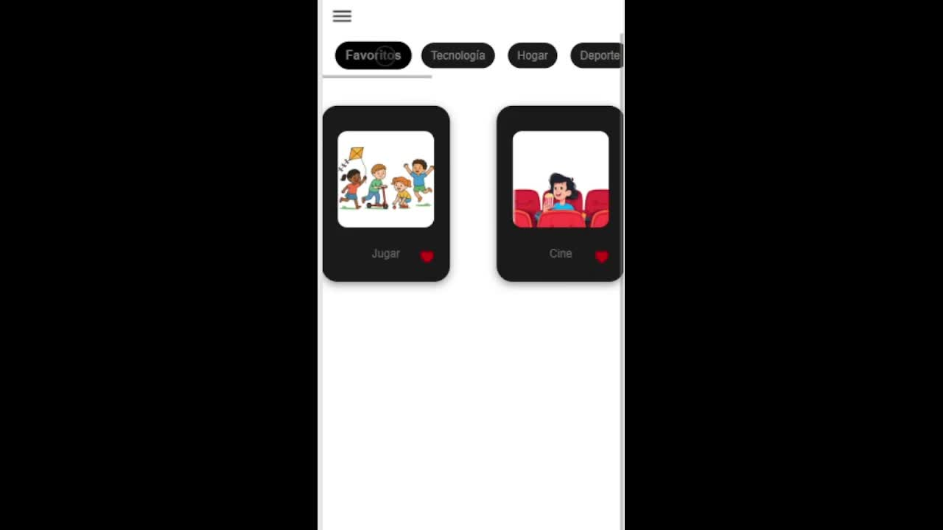

Slide 14


DEVELOPMENT OBSTACLES
During the development of the project, we faced several challenges that affected its progress:
Technical
Organizational
Personal
Errors and bugs in the code.
Integration of different technologies.
External offices and libraries.
Infrastructure and resource limitations.
Lack of documentation or references.
Team coordination and sprint planning.
Frequent changes in requirements.
Difficulty prioritizing tasks.
Time constraints.
Difficulties in decision-making at critical moments.
Personal situations that affected concentration and availability.
NeuroVoice

Slide 15
NeuroVoice
LESSONS LEARNED
Technologies and development
Methodology
Personal and professional
Flask Handling
API creation
Using SQLite
App Customization
TTS Implementation
Front-back development
Project from scratch
Epic-based management
Planning with Sprints
Agile methodology
Continuous feedback
Adaptation to schedules
Team coordination
Adaptability to change
Handling personal problems
Personal growth

Slide 16
THANK YOU
FOR YOUR ATTENTION

